Slide 1
Introduction to the Trades
Ideas for post high training and employment

Slide 2
The trades
Hands on work focused mainly on new construction or residential upgrade/improvement.
Opportunities for training and job placement for students immediately following graduation.
Ability to earn a good living wage and start on the job training right away
Work towards a strong career without pursuing additional training at a college or university

Slide 3
Ways to get started now
Volunteer in any of the trades, help a neighbor or friend with a project
Classes to explore: Art, Construction, Robotics, Engineering, Drafting, math, math, math
Start trade labor, show up on a job site and ask questions about how to start
Participate in Habitat for Humanity
Complete job shadows, interviews of people in a field of interest
Make connections in the field, collect letters of recommendations

Slide 4
Overview of the Construction Trades
Labor Positions - Examples!
Operator
Electrician
Laborer
Carpenter
HVAC
Sheet Metal Worker
Roofer
Painter
Plumber
Elevator Installer
Drywall Installer
Mason
Tiler
Welder

Slide 5
Support and Leadership Positions
Support Positions
Supervisors
Business - Accounting, Office Manager
Safety
Human Resources
Education required (most times)
Architect
Engineer
Company President
Project Manager

Slide 6
Training Opportunities
Apprenticeships
Training often little or no cost to learn the position, training often at night, work in the field during the day. Takes about 4 years.
On the job training
show up ready to learn
Certificate programs or 2 year degree, often @ community colleges
2 Year Interior Design at Portland Community College
Plumbing apprenticeship certificate - Clackamas Community College
4 year degree - College or University (rarely required)
Examples
1)Construction Engineering Management - OSU
2) Architecture Bachelor’s Degree - University of Oregon

Slide 7
Characteristics of workers employers are looking for:
Initiative
Communication Skills
Willingness to dig in and work hard
Problem Solving
Reputation is huge!

Slide 8
Wages and Earning Potential
Most tradespeople will acquire NO debt for training and schooling.
You will have great benefits, often family medical insurance, disability insurance, and with time retirement planning options.
Wages vary by trade, but can start at $14-18 from day one, with often guaranteed raises every 2-3 months!
If pursuing an apprenticeship you can end your training making $25-35/hour.

Slide 9
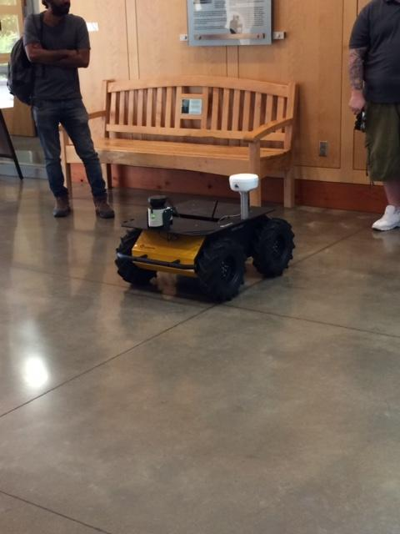
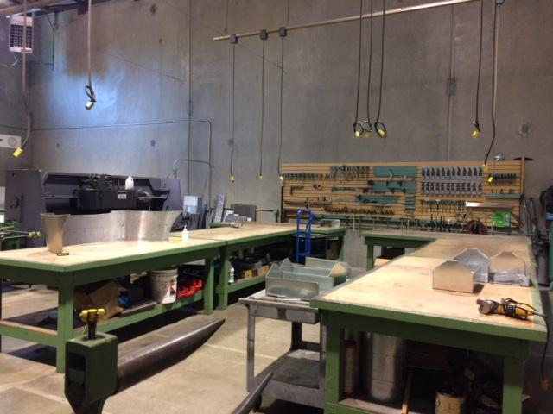
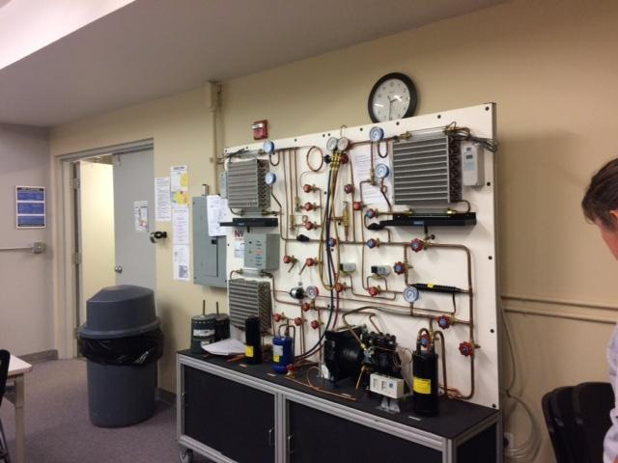
Types of Projects
Insert p

Slide 10
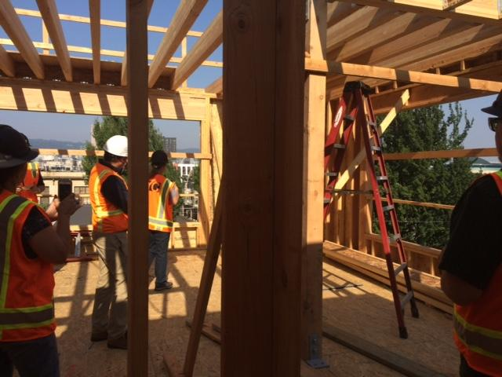
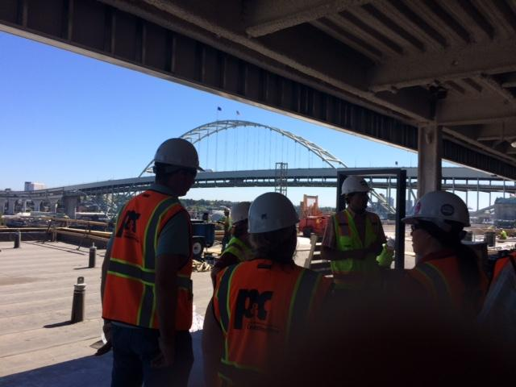
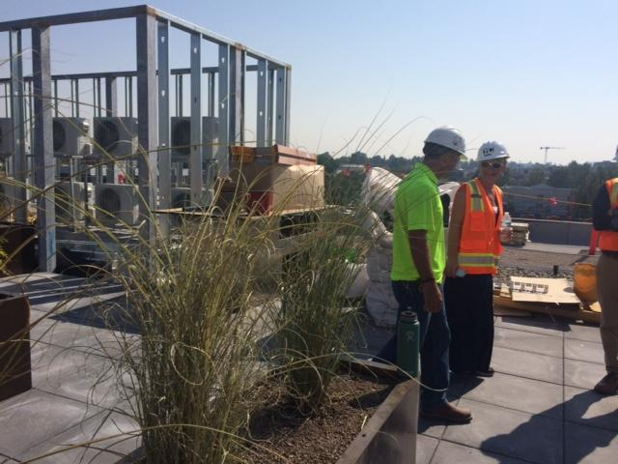
More photos

Slide 11
Follow up with interest
Request a meeting with the career and college counselor to start work on yuor plan or to expand your knowledge of what steps to develop a plan
Identify the steps necessary to execute the plan
Visitation to apprenticeship sites, job shadows or interviews with individuals in the field

