Slide 1
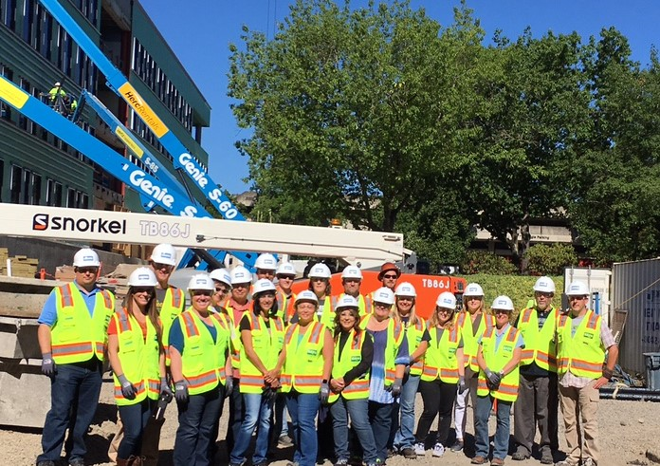
Career opportunities in the Trade Industries

Slide 2
Career Opportunities
The construction industry is the nation’s largest single industry. It employs more people and contributes more money to America’s bottom line than any other single industry.
skilled trade workers
Designers
management positions
support staff
These jobs can be permanent, well-paying construction careers that exist in all areas of the industry.

Slide 3
Training Opportunities
Apprenticeship Programs
  Northwest College of Construction
  Pacific Northwest Carpenters Institute
  Sheet Metal Institute
  Laborers
Community College
  Chemeketa Community College
  Linn Benton Community College
On the job training

Slide 4

Education
High School Diploma
GED
Modified Diploma

Slide 5

Employers are also looking for qualified individuals who possess
“soft skills”…

Slide 6
Where to find jobs
Build Oregon www.build-Oregon.com
Pipeline to Jobs www.pipelinetojobs.com
DJC Oregon www.djcoregon.com
Individual Company Websites
Word of mouth
Employee Recommendations

